Slide 1


Putting the Success In Succession Planning: Documenting an E-resources Librarian Position
Danielle L. Ostendorf
Colorado School of Mines
danielleostendorf@mines.edu
Notes:
All docs and slides are saved in Danielle’s Google Drive.
Presentation Type: In-Person Session (30 min + 20 min Q&A)
Conference Track: 3. Organizational Strategies & Promotion
Audience Level: Intermediate
Keywords: succession, documentation
Learning Objectives; Following this session, participants will be able to:
Identify Key Strategies: Attendees will be able to identify and articulate essential strategies for effective succession planning specific to electronic resource librarians, including knowledge-sharing practices.
Develop A Plan: Attendees will be given templates to create actionable plans to implement succession planning initiatives within their own libraries. They can be used as is or tailor them to their organizational needs and resources.
Abstract
This presentation explores one e-resource librarian’s efforts to reorganize years of documents and create a succession plan. Succession planning is important to transfer knowledge and ensure seamless transitions in library leadership. Attendees will gain insights into best practices for fostering resilience and continuity within library services, ultimately enhancing organizational effectiveness.
Statement of Originality and Diversity
This presentation offers an original individual perspective on succession planning for electronic resource librarians by addressing unique challenges within library settings. By emphasizing inclusive mentorship and collaboration, it fosters an environment with richer, more innovative approach to leadership development in the library community. Additionally, not much has been published or presented on this topic.
ER&L image credit: https://electroniclibrarian.org/official-logos/

Slide 2

Succession
Planning
“Succession planning, which involves documenting and transferring knowledge from an outgoing employee to a new staffing situation, is ultimately about change management.”
Carolyn Schubert (2021)
American Libraries Magazine
Succession Planning
Introduction – About Succession Planning
Notes:
In this presentation, “succession planning” is not referred to as replacing a CEO from existing board members while fitting in company goals or the succession of the monarchy. Instead, it focuses on the succession of a position for an interim to cover the duties or a new hire to succeed in the new position due to the availability of information and data upon arrival.
Schubert, C. (2021). Building a Better Tomorrow: Intentionally rethinking work through succession planning. American Libraries Magazine. https://americanlibrariesmagazine.org/2021/11/01/succession-planning-building-a-better-tomorrow/
Image credit: https://www.britannica.com/list/5-fascinating-british-coronation-objects

Slide 3
Succession planning is proactive… you are ahead of the curve, anticipating, developing, and ensuring that the key work is accomplished by top flight staff, and that knowledge is shared and transferred in a healthy, collaborative way.
Succession Planning in the Library:
Developing Leaders, Managing Change
Singer & Griffith (2010)
“
Succession Planning
Introduction – About Succession Planning
Notes:
Singer, P. M., & Griffith, G. (2010). Succession planning in the library: Developing leaders, managing change. American Library Association.
Underline image credit: https://vistatrailbikes.com/employment/

Slide 4
What is succession planning/change management for an e-resources librarian?
Clear, concise, up-to-date documentation
Access to historical information in a convenient location
Understanding duties beyond the job description
Ability for someone else to get the job done
Optional: Leave contact information and be a resource
Notes:
Learning objective #1 from proposal:
Identify Key Strategies: Attendees will be able to identify and articulate essential strategies for effective succession planning specific to electronic resource librarians, including knowledge-sharing practices.
Underline image credit: https://vistatrailbikes.com/employment/

Slide 5



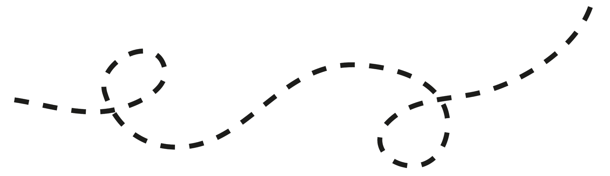


My Experience
10 years as an e-resources librarian
Worked for 3 institutions with drastically different succession plans:
  2014 – 2018 @ University of Minnesota Duluth
  2018 – 2021 @ University of Colorado Anschutz Medical Campus
  2021 – now @ Colorado School of Mines
Working at Mines
  7k+ FTE, R1, STEM focus
  20 library staff members
  5 Collection Management
    1 Head & E-resources Librarian
    2 Metadata Librarians
    1 Gov Pubs Coord
    1 Acq & Cat Tech
Succession Planning
About Danielle’s Succession Planning
Notes:
The three institutions I have worked for had drastically different succession plans upon my arrival. When I started at the University of Minnesota Duluth, I was lucky enough to work with my predecessor, who worked at the University of Minnesota Twin Cities. This resulted in constant collaboration between the campuses. At Anschutz, I didn’t have a connection to my predecessor, but of the three institutions, they were the most organized, and we worked to continue that organization. Lastly, at the Colorado School of Mines, it was apparent upon my arrival that little to no documentation existed, organization was lacking, and the entire process of this presentation needed to be created from scratch.
Image sources:
State images: https://www.communityjusticeexchange.org/en/nbfn-directory
Dotted line: https://littlebeebooks.com/
UMD: https://umpr.d.umn.edu/brand/about-our-brand
CU Anschutz: https://www.cuanschutz.edu/offices/communications/brand/logos-and-marks
Mines: https://brand.mines.edu/logos/

Slide 6
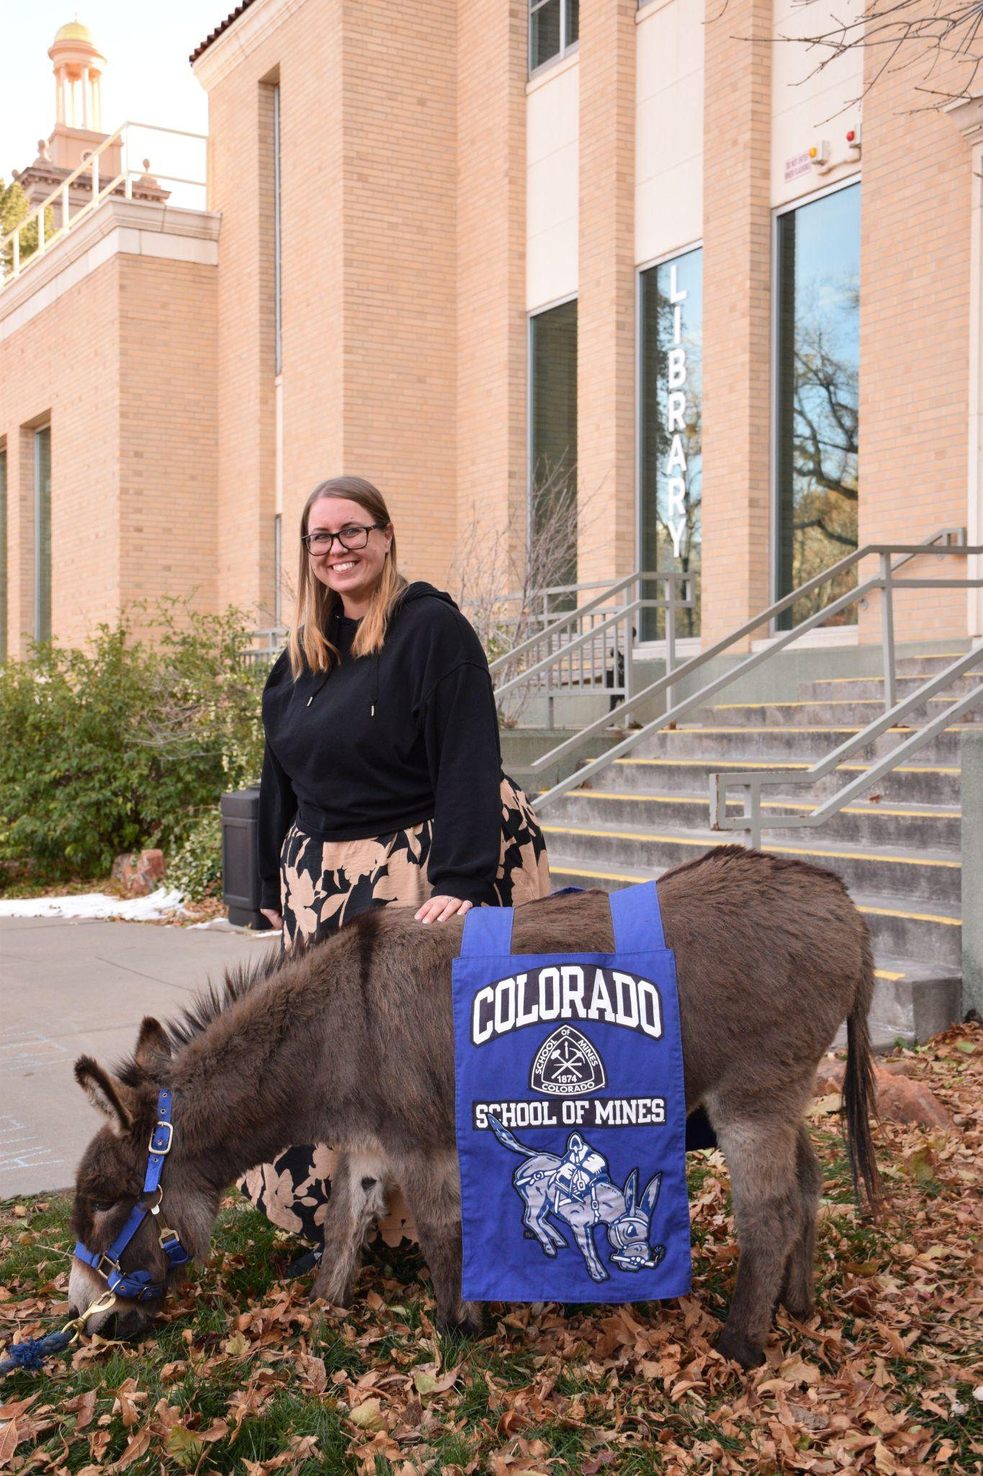
Inherited at Mines
Lack of Organization
A filing cabinet and 15 banker boxes of physical files stored across the library
Docs in a local shared drive & SharePoint
Multiple email inboxes for vendor comm.
*no shade*
Expectation vs Reality
Documentation was rare, outdated, or quickly put together by the interim
Lacking vendor admin data
Missing data (licenses, usage, invoices, etc.)
Library Staff Turnover
Regular turnover in collection management and across the library
Turnover of our ILL position during 2024 proved this should be a priority for all staff
Succession Planning
About Danielle’s Succession Planning

Slide 7

Lack of Organization
Sort through print files and scan items to be saved in the cloud and toss all print files
Create a file structure for each vendor with invoices, agreements, usage, etc.
Move all documents to SharePoint and date everything (in the file name and on the doc)
Eliminate other emails and prioritize use of liberes@mines.edu for vendor communication
Expectation vs Reality
Acknowledging I am one person doing this job (similar to my predecessors)
“How I did it” ≠ “this is how you have to do it”
Regular updating and maintenance will now be a priority – add it to calendar
Realizing more could’ve been done for my prior positions, and I hope to do more for this and future position(s)
Library Staff Turnover
Writing it into my goals for 2024 and leveraging it toward my faculty scholarship responsibilities
Writing it into my employee’s goals for 2024-2025
Encouraging documentation across the library and encouraging inclusion in the library’s strategic plans
Succession Planning
About Danielle’s Succession Planning
Notes:
Image credit: https://pixelsmerch.com/featured/leave-it-better-than-you-found-it-earth-day-eco-mister-tee.html?product=sticker

Slide 8
Documentation

Slide 9

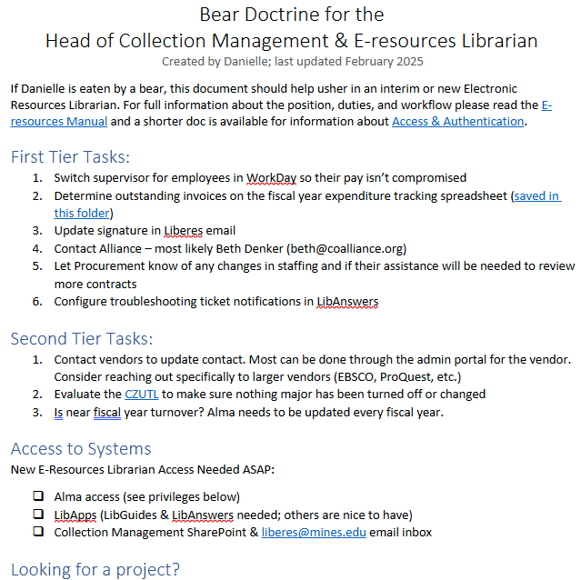
Bear Doctrine
The bear minimum!
  aka what someone would absolutely need to know when trying to do the job
  if I’m eaten by a bear
1-5 page doc of what someone would need to know when trying to do the job
Consider including:
  Priority tasks
  Required access to systems
  Projects started and not finished
  Known future opportunities/projects
  Who did what during the interim?
🔗Danielle’s Version
Older versions in slide notes
Succession Planning
Documentation – 1 of 3
Notes:
Examples of Bear Doctrines:
Colorado School of Mines: https://docs.google.com/document/d/1J6nn6TXxpM3VQ3g2O6FuwA8Qn0OJSb_3QyZDorWfI0A/edit?usp=sharing
CU Anschutz: https://docs.google.com/document/d/1LgxhaI2vSZmpK6pbn73VVAgKJOSGZ_Mt/edit?usp=sharing&ouid=102733751152090710060&rtpof=true&sd=true
University of Minnesota Duluth: https://drive.google.com/file/d/12ok2sI-bAMF2P428ZJZFfgeBKBzD17ZV/view?usp=sharing
Bear image credit: https://itoldya420.getarchive.net/amp/media/wild-brown-bear-animals-bb7c2f

Slide 10
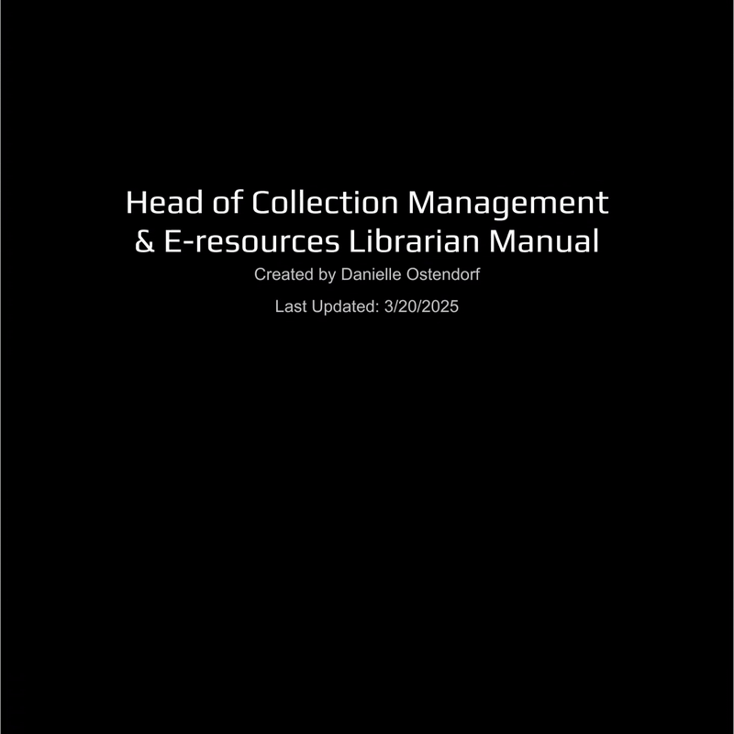
E-resources Manual
20+ pages and still growing
Document uniqueness and invaluable institutional knowledge
Link out to relevant documentation at the institution or on vendor sites
Concurrent work: identifying what documentation needed to be created for specific workflows, processes, and known issues outside of the manual
🔗 Danielle’s Manual
Succession Planning
Documentation – 2 of 3
Notes:
Danielle’s Example Links:
Word > Google Doc Version: https://docs.google.com/document/d/17iCjO0rH1V4FAUDiF0qc-Oh_huRUBb2TFLVIsIppUh0/edit?usp=sharing
PDF Version: https://drive.google.com/file/d/1K8IFmULAkA31Gb0HZLrurIMP-FYiFeIQ/view?usp=sharing

Slide 11
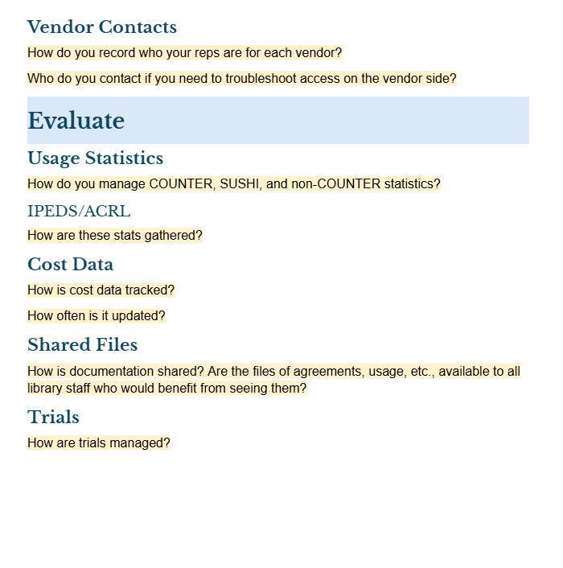
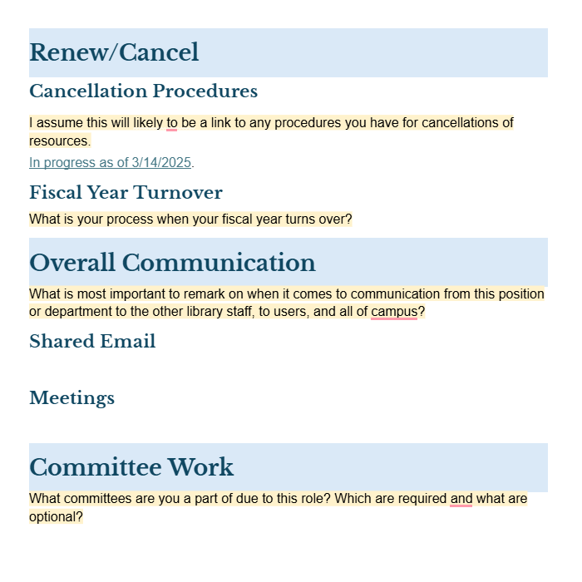
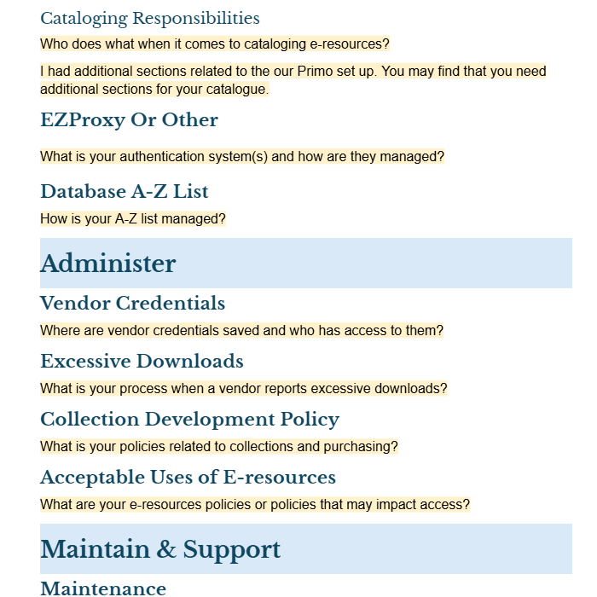
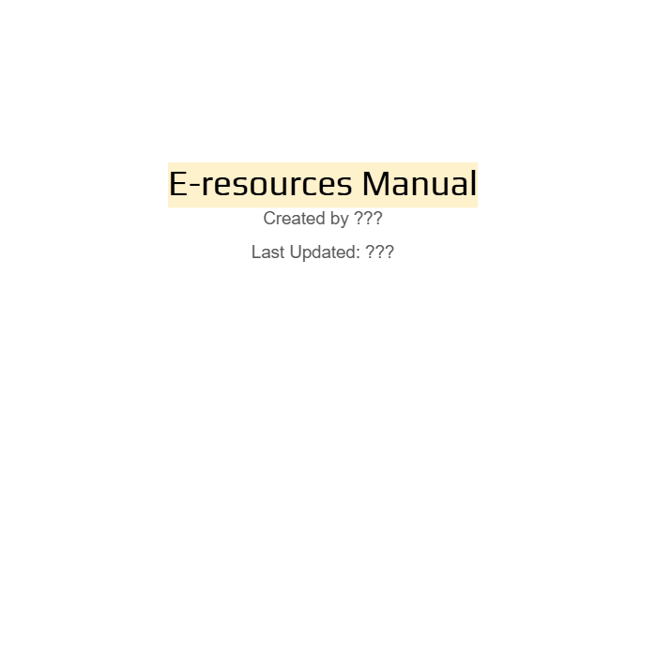
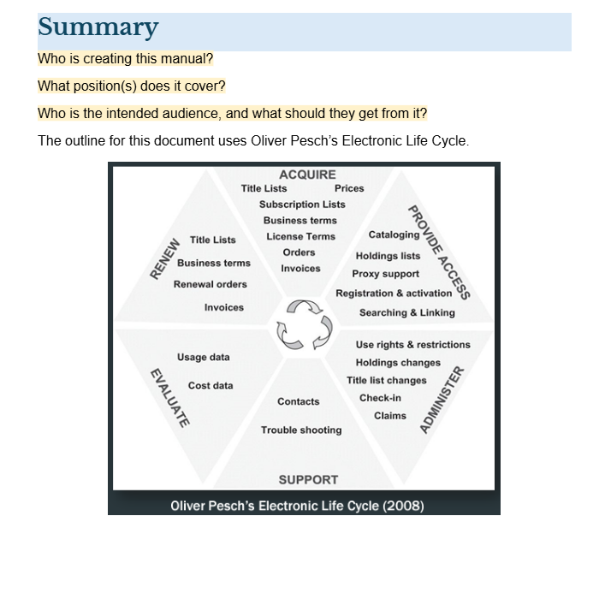
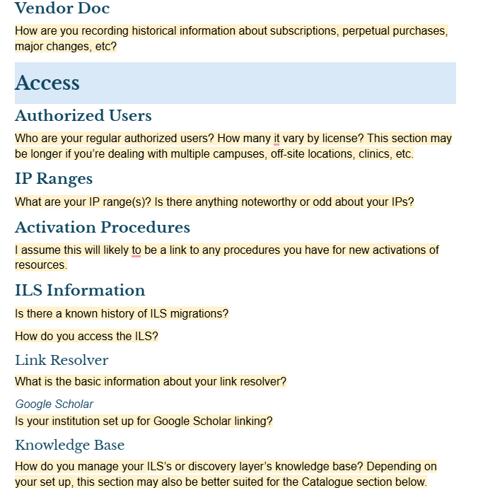
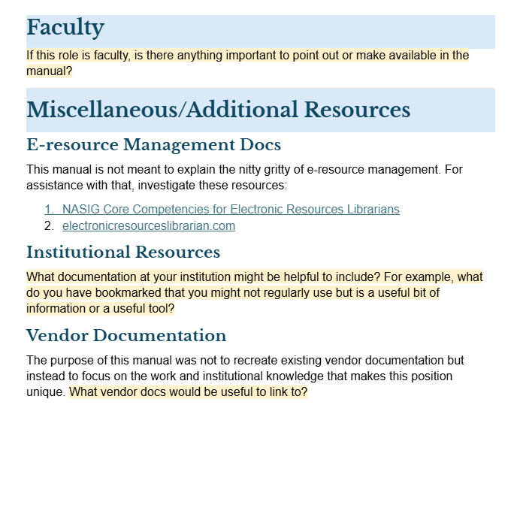
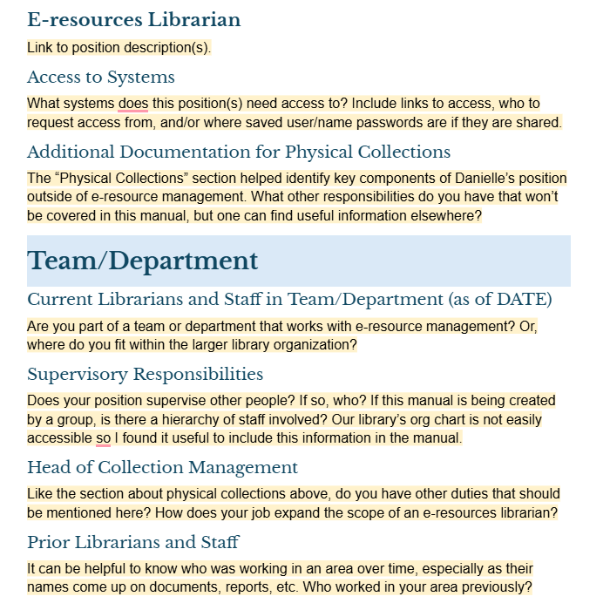
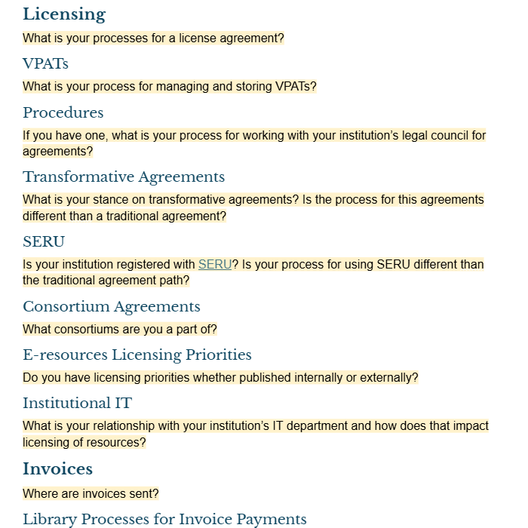
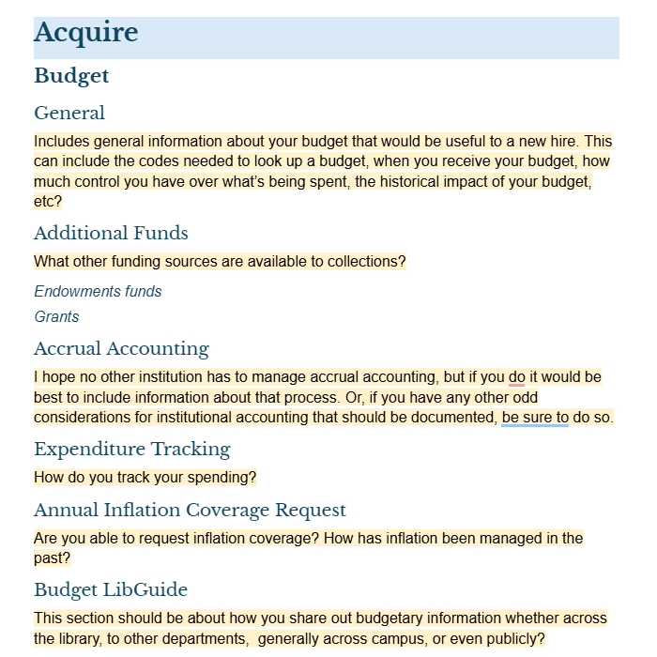
E-resources Manual
Structured on the ERM Lifecycle
Customize it to your work and institution
  OR, work as a team to document the e-resources workflow if multiple staff are involved
Look at job description(s) to make sure all duties are covered
🔗 Template for you!
Make it your own :)
Succession Planning
Documentation – 2 of 3
Notes:
Template Link: https://docs.google.com/document/d/19Ox77neeYONRnS0rMOK6_MRrwwwCO9m7U3EhkVvMxlA/edit?usp=sharing

Slide 12
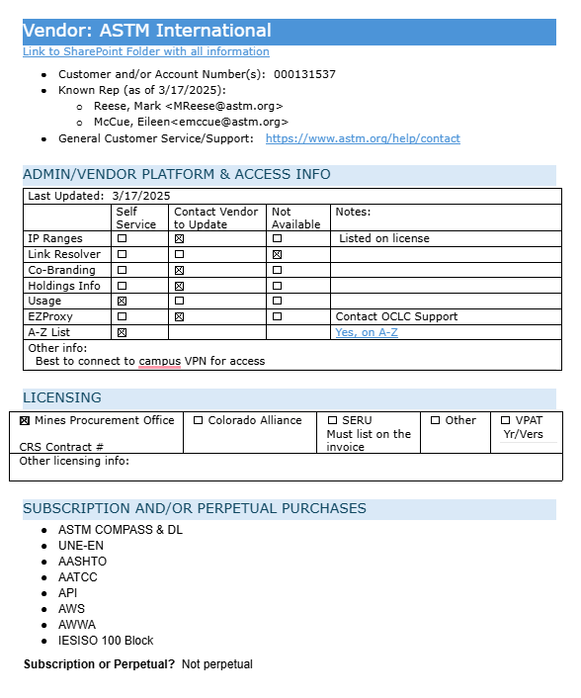
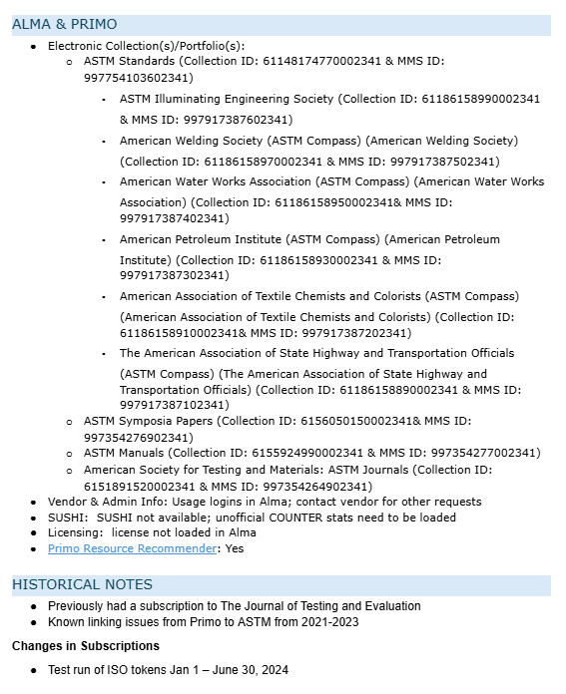
Vendor
Doc
A template that works for my institution to document purchases and vendor activity
Still working to complete across FY25-FY26
Concurrent work: collecting missing usage, invoices, agreements, etc.
Concurrent work: data spreadsheet of cost increases and cost per use
🔗 Danielle’s ASTM Example
Succession Planning
Documentation – 3 of 3
Notes:
Danielle’s ASTM Example Link: https://docs.google.com/document/d/1PYFwiDD36bKflJDuNPfQnVdHs4ZYgjfFXKG0GhFDCbs/edit?usp=sharing

Slide 13
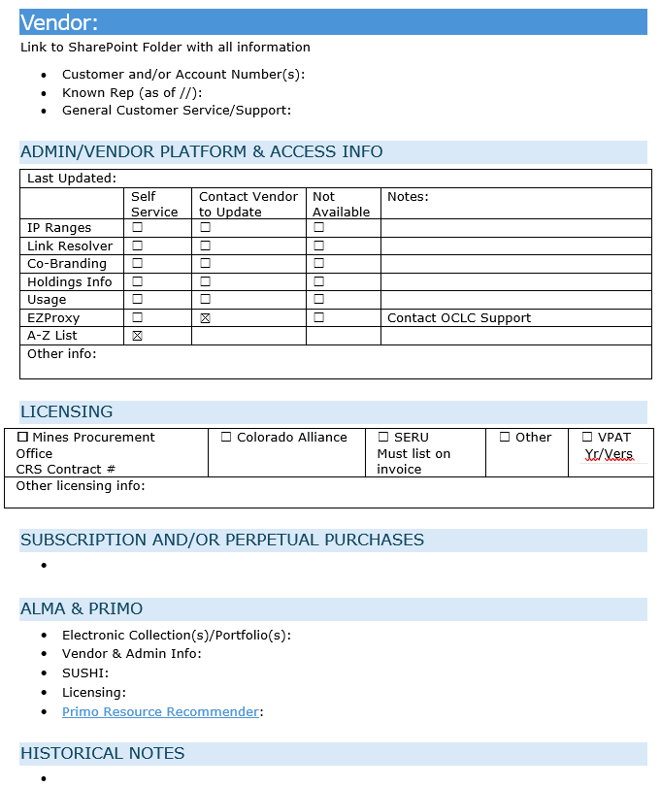
Vendor
Doc
Determine what will work with you and your institutional needs
Shout out: Collection Scorecard at ER&L 2019
🔗 Template for you!
Make it your own :)
Succession Planning
Documentation – 3 of 3
Notes:
Shout out to Katharine Macy & Tina Baich, (Indiana University–Purdue University Indianapolis) IUPUI University Library that shared a Collection Scorecard at ER&L 2019: https://hdl.handle.net/1805/18524
Template Link: https://docs.google.com/document/d/1vbpEoe1MD8UfKg3jE0uTTa7zxaY6JMACXis7Hssb0sQ/edit?usp=sharing

Slide 14





Your Steps to Success
Make a Plan
Write Bear Doctrine
Organize Documentation
Create E-resources Manual
Establish
Vendor Doc
Understand Scope
Establish project timeline
Add to individual goals/strategic plans
Determine how to manage old docs
Understand audience
Just do it!
Can be done in a day
What are the absolute musts of getting the job done?
If you aren’t going to do anything else, prioritize this
Touch every doc
Follow institution retention policy
(sort of)
Document holes to fill later
Scan print docs
Single email inbox and save important info in cloud storage
Start slow
Determine what will be in the manual vs what will be linked to
Divide and conquer to complete/docathon
Focus on unique institutional knowledge
Cross train, if possible
Focus on what’s important
Go vendor by vendor to establish doc
Some vendors with multiple products may be better to have more than one doc
Include in renewal process
Succession Planning
Actions for Succession Planning
Notes:
Learning objective #2 from proposal:
Develop A Plan: Attendees will be given templates to create actionable plans to implement succession planning initiatives within their own libraries. They can be used as is or tailor them to their organizational needs and resources.

Slide 15
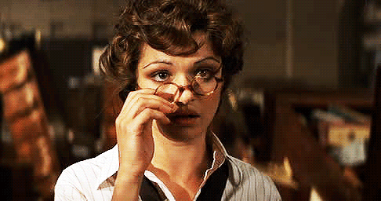
Don’t let
the pieces
crumble
Annually update
Bear Doctrine
Build Vendor Doc into renewals
Annually update ERM Manual
Continuous cleanup &
maintenance of this plan
Succession Planning
Actions for Succession Planning
Notes:
Gif Credit: The Mummy (1999); gif from https://imgur.com/gallery/JJHTt/comment/164110380

Slide 16

Remember to Breathe
Succession Planning
Actions for Succession Planning
Notes:
Gif Credit: https://www.google.com/url?sa=i&url=https%3A%2F%2Fwww.forher.org.uk%2Fapps%2Fheadspace-app&psig=AOvVaw1xqICtzeTymaXQmiNxN5yI&ust=1742486705732000&source=images&cd=vfe&opi=89978449&ved=0CBMQjRxqFwoTCOiu5fzClowDFQAAAAAdAAAAABAm

Slide 17
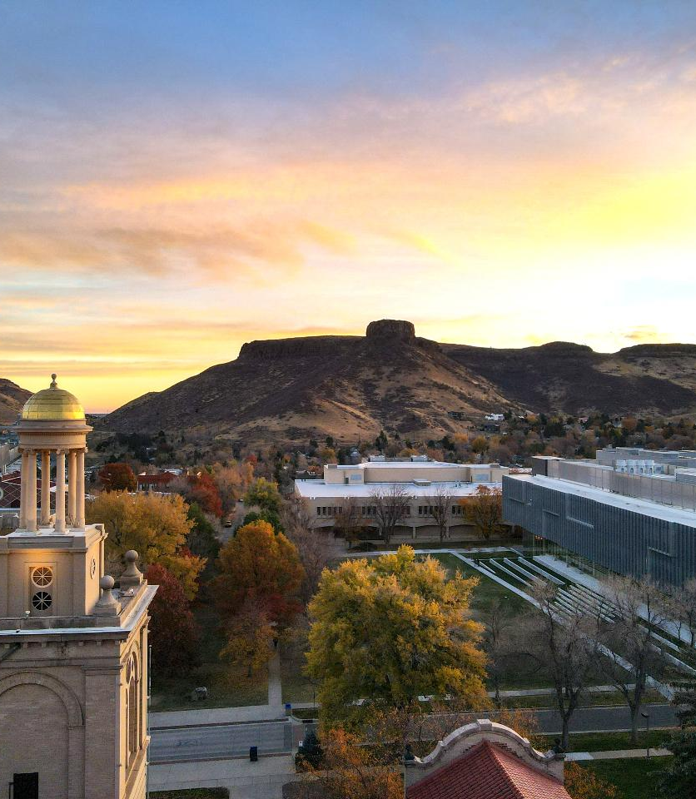
Discoveries
Conclusion
How this work has impacted Mines:
AAAS license for Science backfiles from 2006
Undocumented backfiles from Wiley
Finding gaps in vendor agreements
Established easier transition were I to vacate my position or unexpectedly be on leave
Offers transparency of my position to others in the library (and across campus)
Create opportunities for internal interest in the position and mentor the next gen ERL
Succession Planning
Conclusion
Notes:
Image credit: https://www.minesnewsroom.com/sites/default/files/2022-12/sunrisedrone_nov2021_dji_0060_resize.jpg

Slide 18
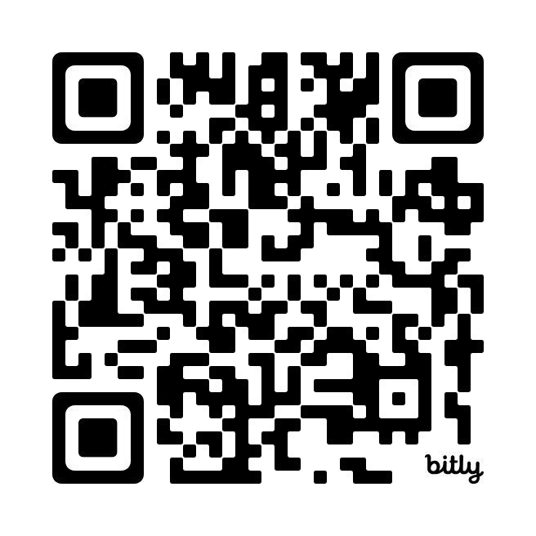
Please consider taking my survey about succession planning:
bit.ly/4itH3So
danielleostendorf@mines.edu
Succession Planning
Conclusion
Notes:
Link to Survey: https://docs.google.com/forms/d/e/1FAIpQLSfVCx_jqaCnMeEmwv2UvdnMmIWj4FGGq7hHCnBGAu0tU_tw5w/viewform?usp=dialog

Slide 19

Thank You!
Questions?
Or, contact me later! danielleostendorf@mines.edu
Notes:
All docs and slides are saved in Danielle’s Google Drive.
Google Slides Templates: Project Retrospective

