Slide 1
HHFMonaziteAutoMin (Automated Mineralogy scans)
Monazite grains shown in blue

Slide 2
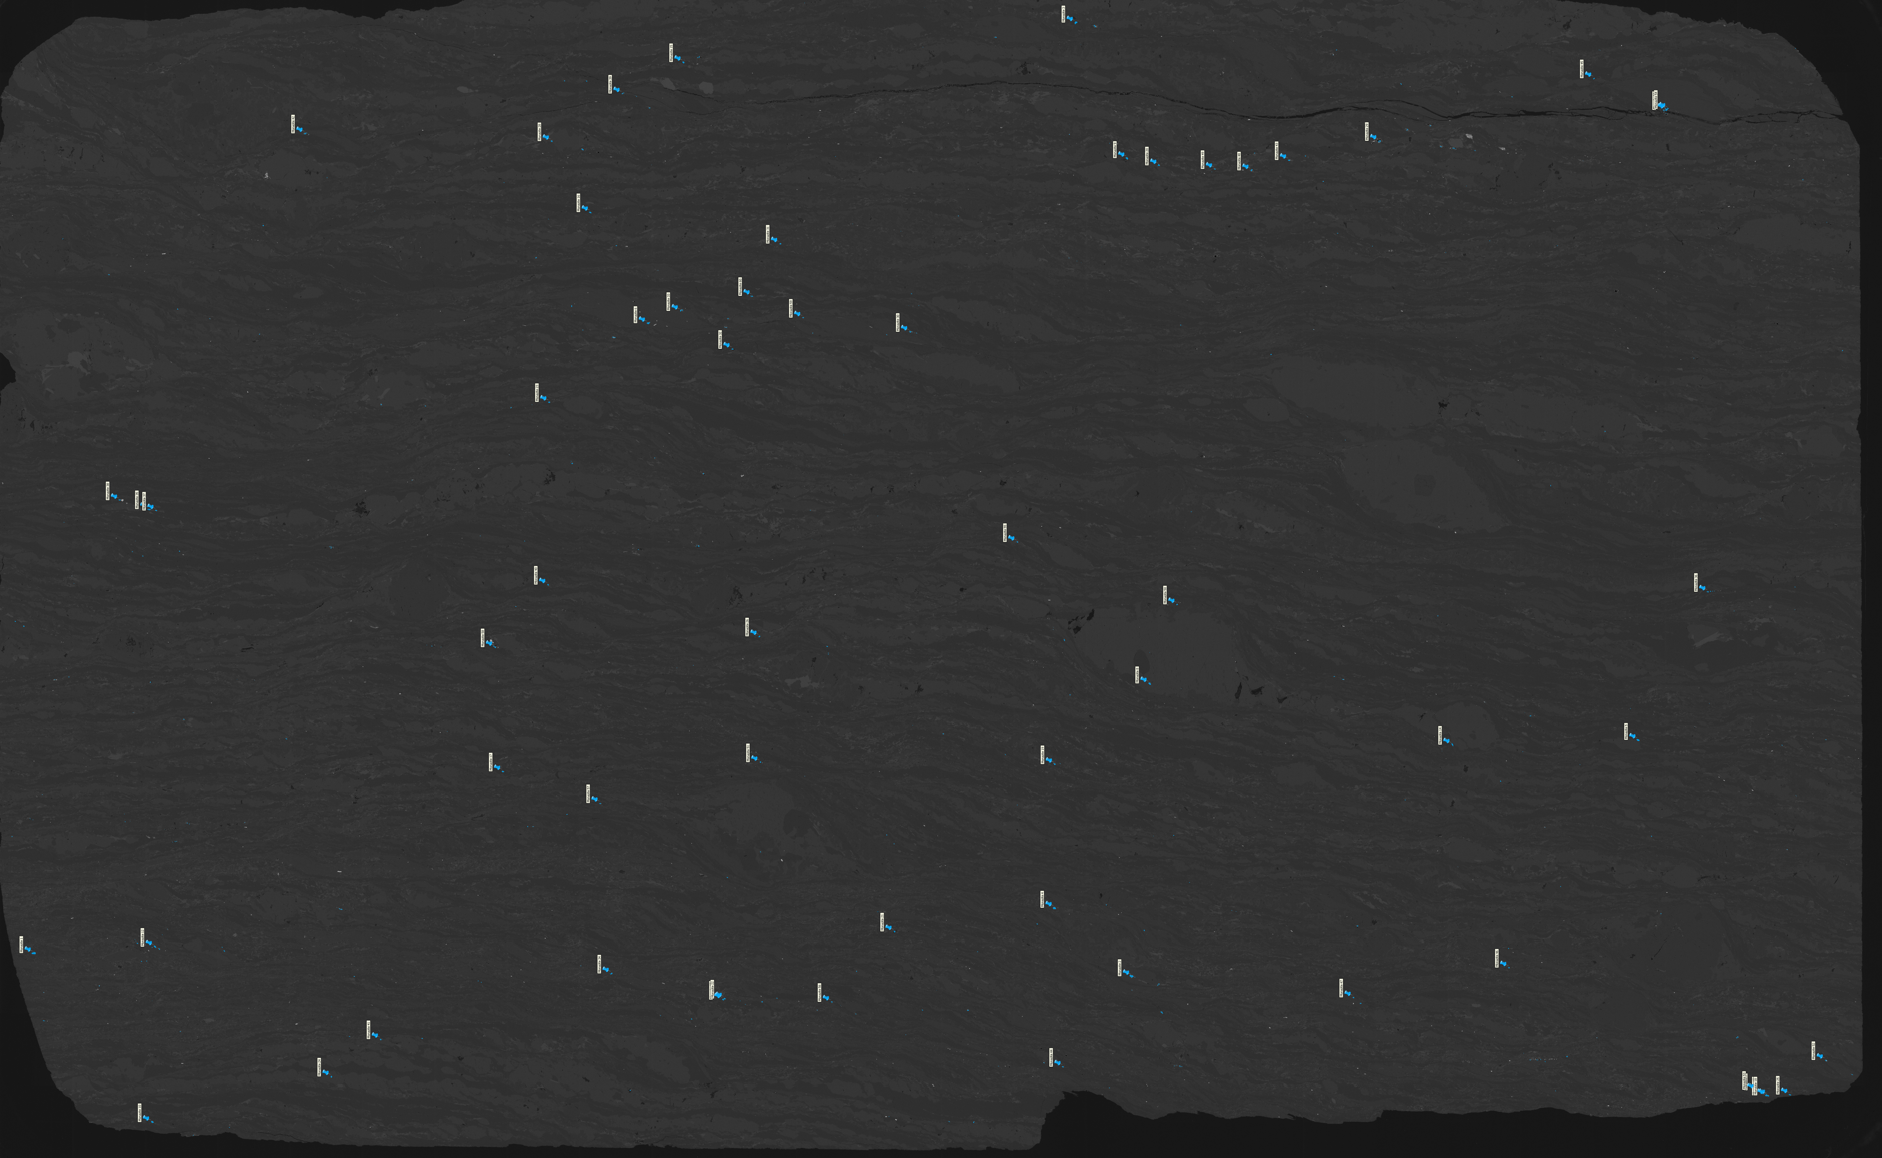
P-4 AM SCAN MAP LABELED

Slide 3

P-4 AM SCAN UNLABELED

Slide 4
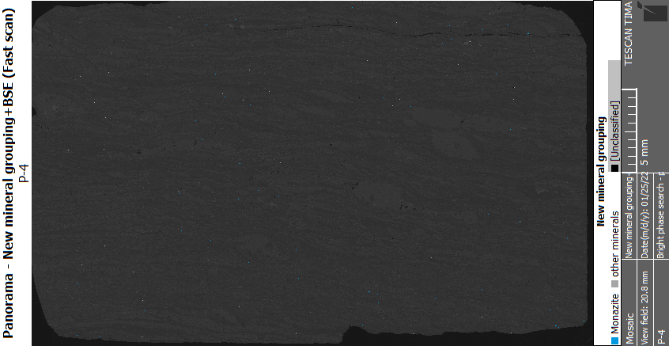

Slide 5
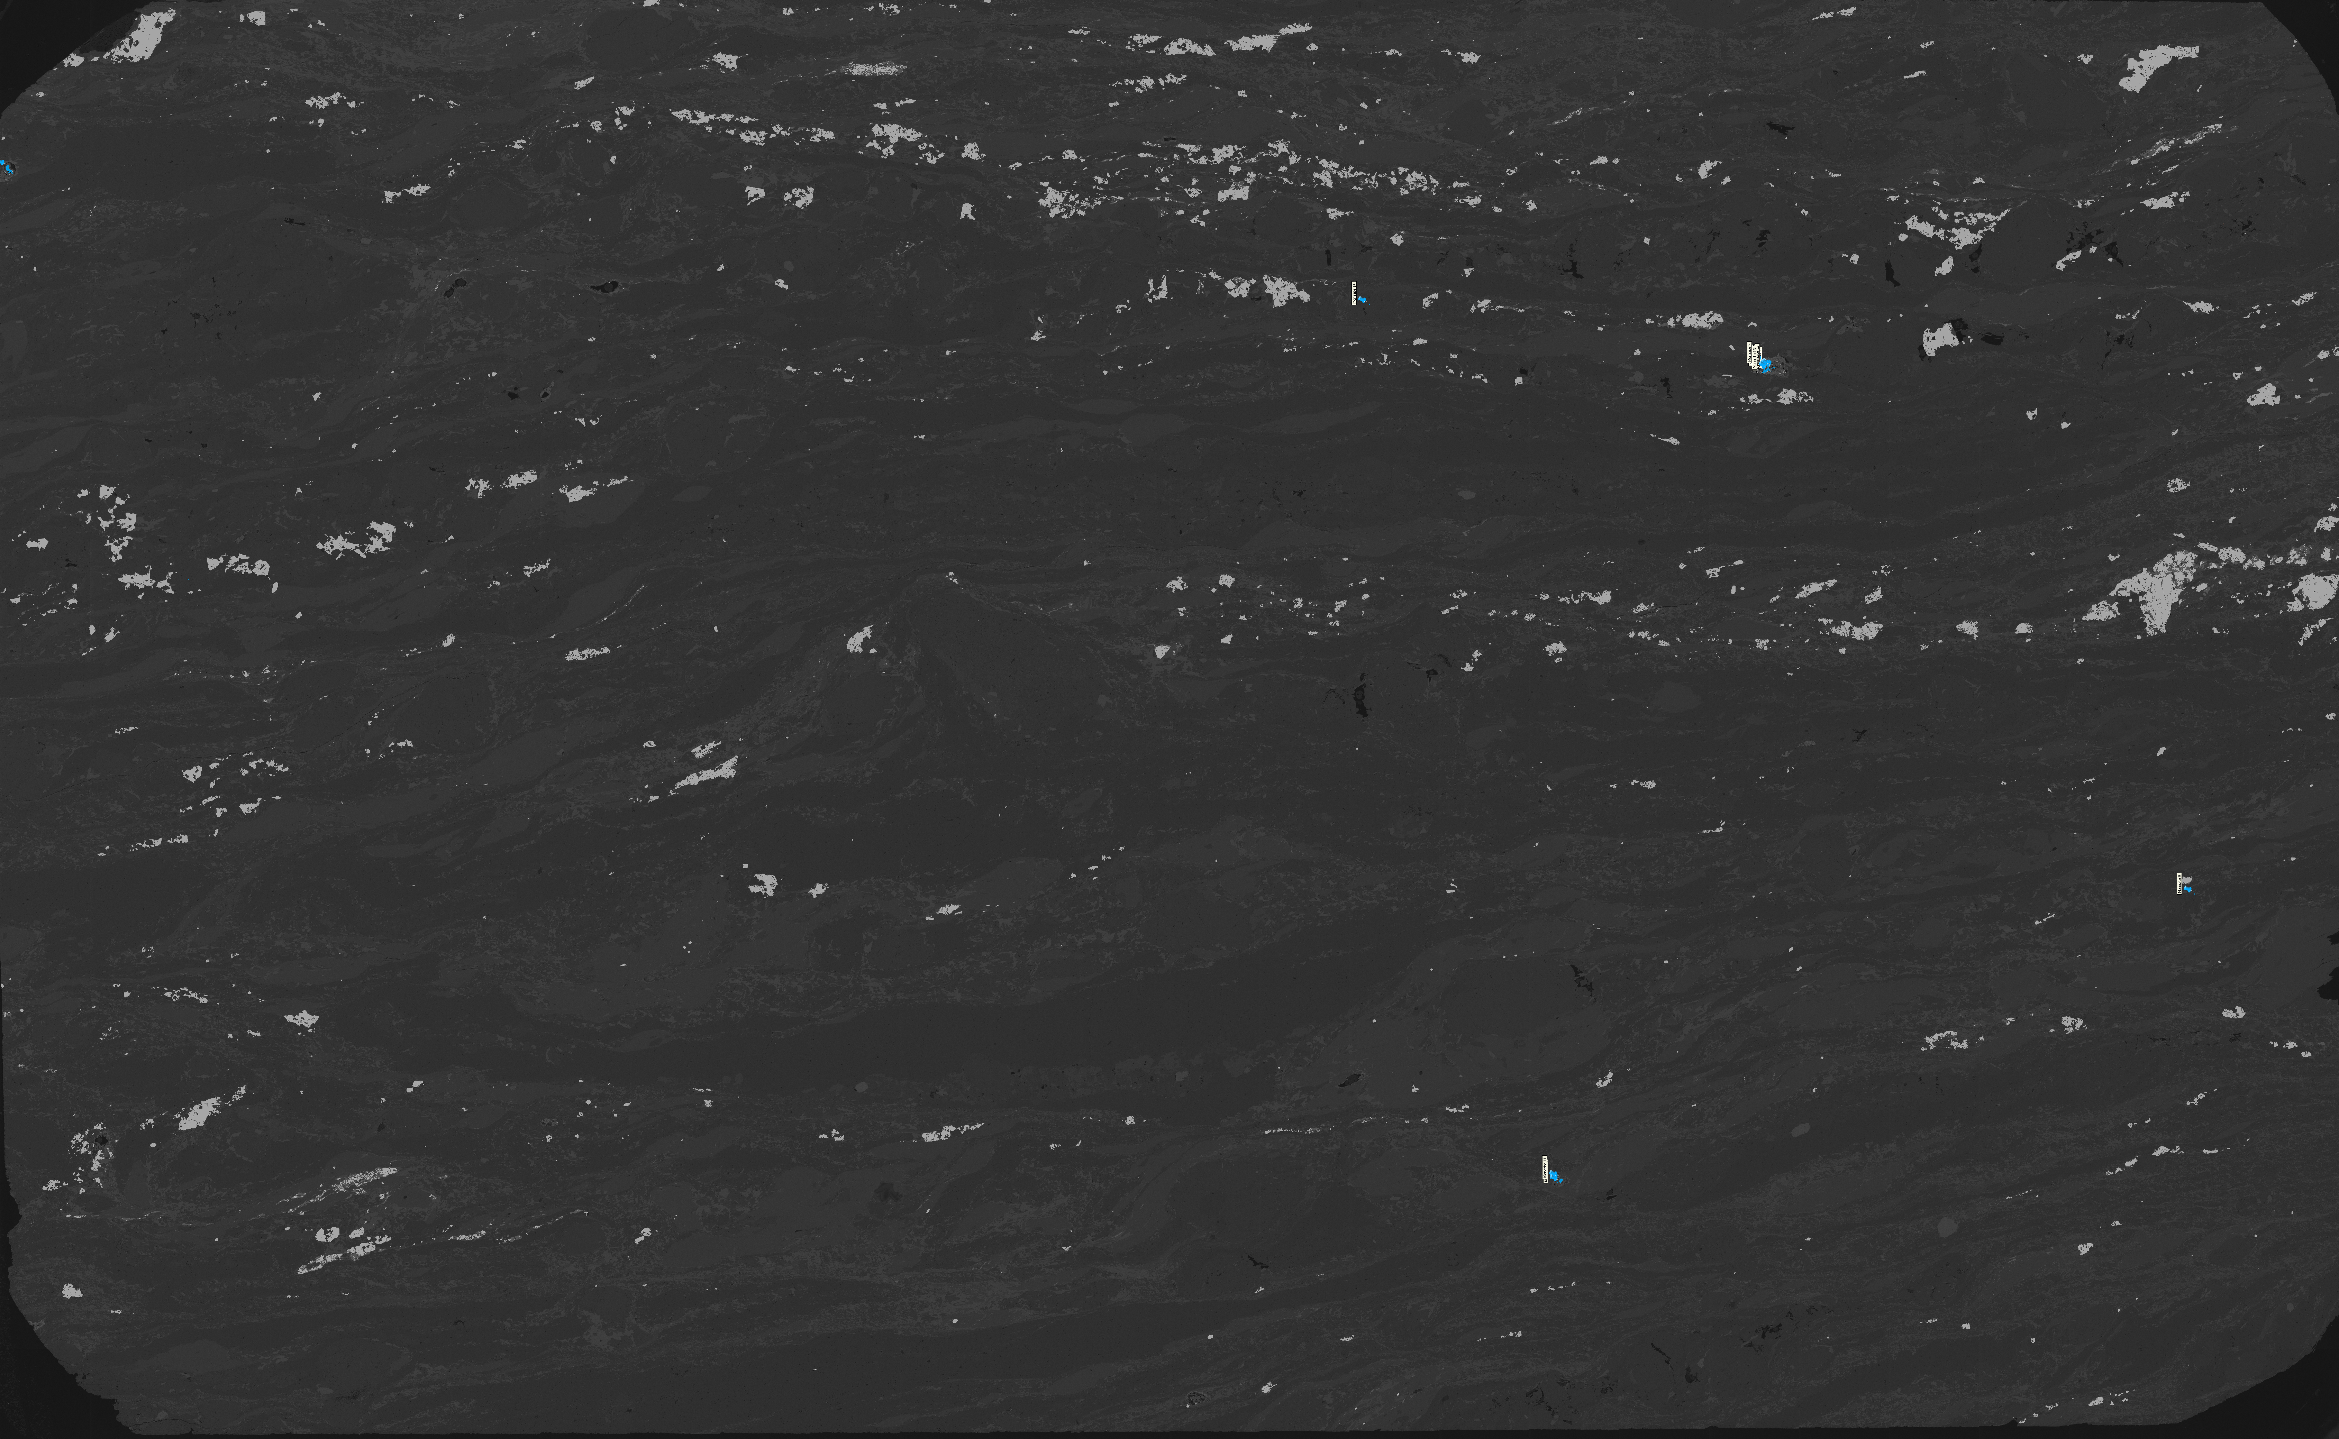
P-208 AM SCAN MAP LABELED

Slide 6
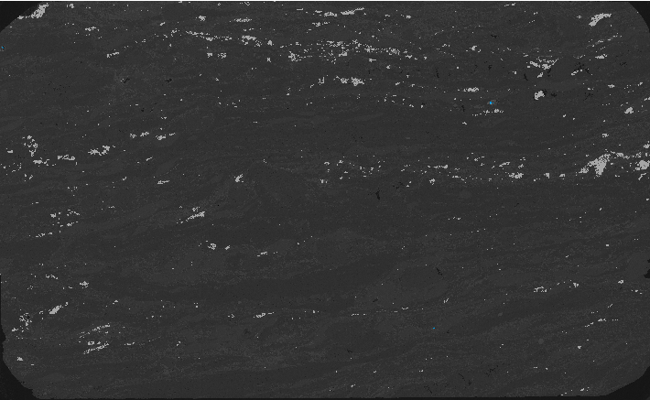
P-208 AM SCAN UNLABELED

Slide 8

AV-583 AM SCAN MAP LABELED

Slide 9
AV-583 AM SCAN UNLABELED

